Slide 1
PiVe: Prompting with Iterative Verification Improving Graph-based Generative Capability of LLMs

Slide 2
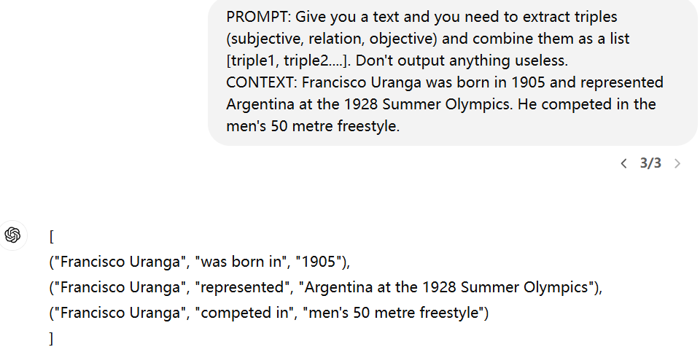
Issue
It’s not good for LLM to generate graph data. LLM cannot capture the entailment of the sentence.

Slide 3
Contributions
Propose a new framework to address the issue of generating graph data.
Create a dataset GenWiki-HIQ
Prove PiVe can be used as a data augmentation technique.
Explore two ways of iteration.

Slide 4
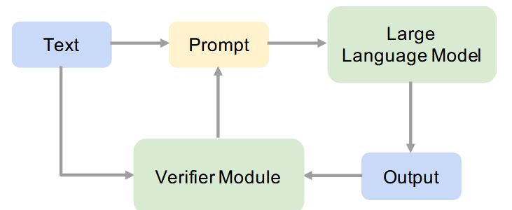
Framework
Original Prompt: Transform the text into a semantic graph: Text: … Graph: “
Iterative Prompt: Transform the text into a semantic graph and also add the given triples to the generated semantic graph.
Some insights myself. Although iterative prompt prevent model from mistaking as before, it will take the wrong answer into the next iteration.

Slide 5
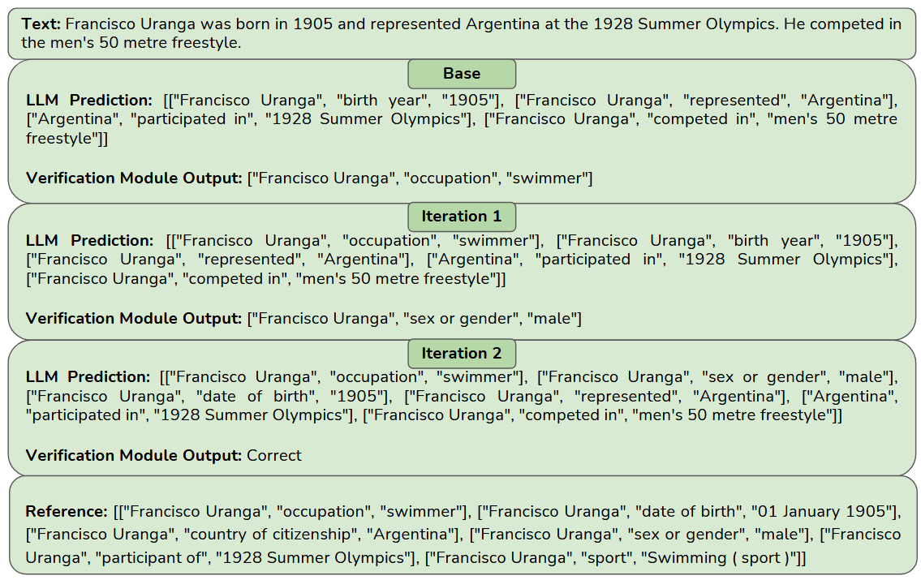
An example

Slide 6
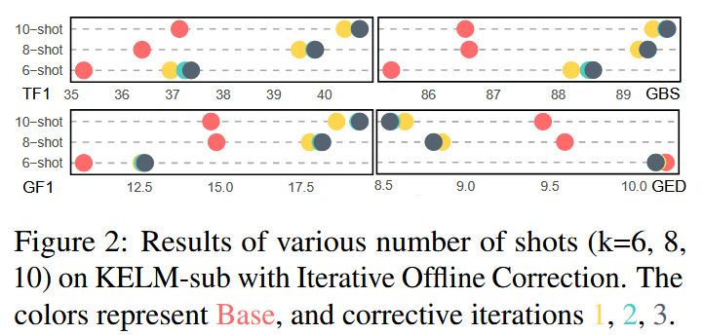
Prompt design
G-ED: measure the edit counts(add, remove) of transforming the generated to ground truth.
G-BS: to find the best alignment of set of edges of the generated and ground truth.
Prompt design is very important for model performance.
The work conducted on few-shot and explore more shots influence on model.
T-F1(Triple F1): calculate the F1 between the generated triple and ground truth.
G-F1(Graph F1): focus on the entire graph and calc F1 between generated and ground truth. When nodes and edges are the same then the graph is same. This metric is calc by NetworkX.

Slide 7
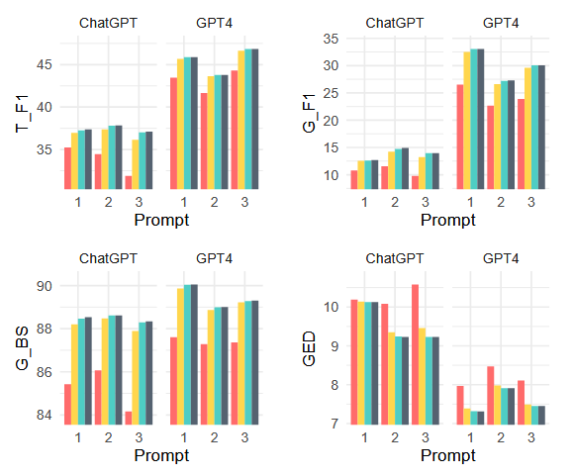
The effect of different prompts
Prompt 1: Transform the text into a semantic graph.
Prompt 2: Transform the text into a semantic graph consisting of a set of triples. Generate as many triples as possible.
Prompt 3: Transform the text into a semantic graph consisting of a set of triples. First produce all relations possible, then produce the graph.
Conclusion:
Prompt 1 is the best.
GPT-4 is far better than ChatGPT

Slide 8
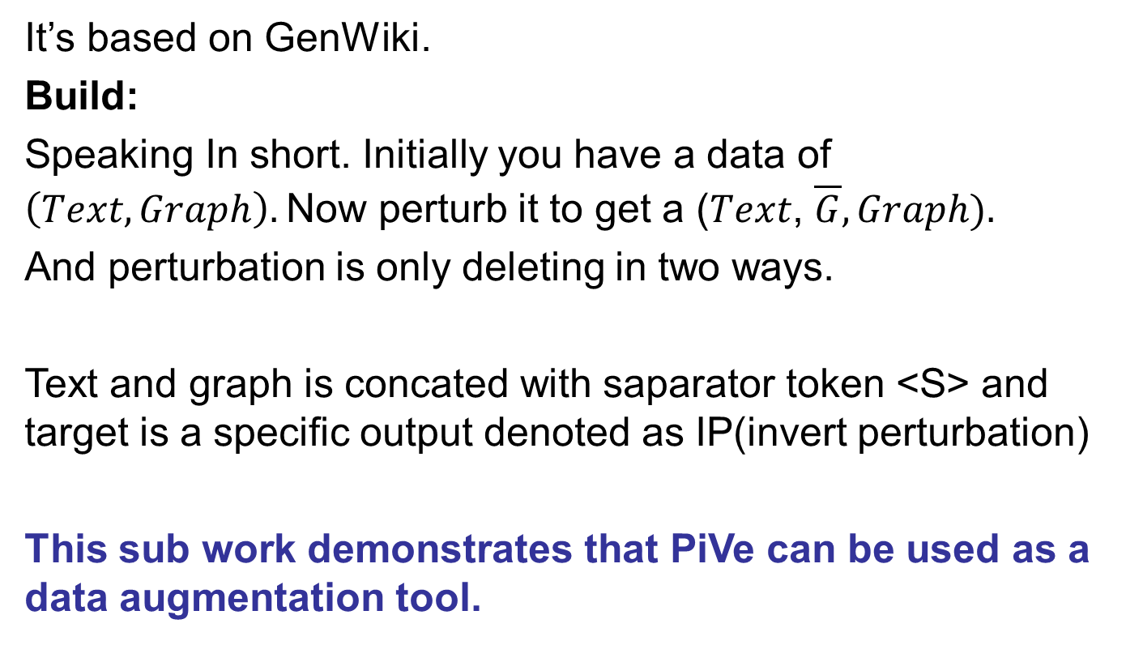
GenWiki-HIQ

Slide 9
Perturbation
Two methods
Random:
(Peter, company, Alice), (Danny, birth, 1902)
Randomly delete one triples and target is to generate the missing triple.
2. Heuristic:
["Francisco Uranga", "occupation", "swimmer"]
Delete triples that not exist in the text.

Slide 10
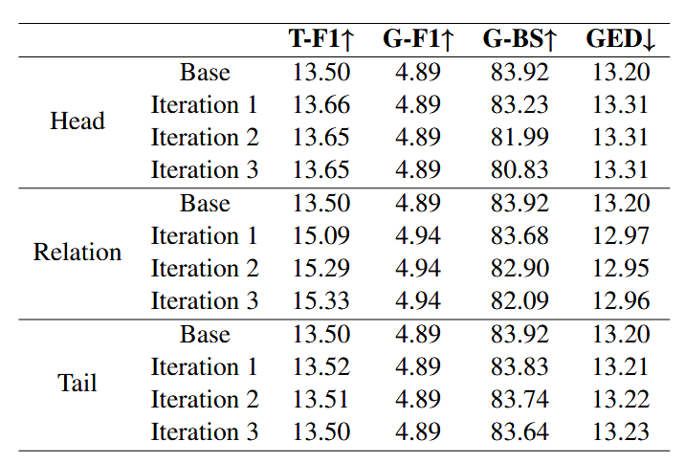
Effect of Perturbation
Notes:
Relation T-F1 up and G-BS down.
This indicates the verifier module could potentially inject wrong corrections if not trained with the proper perturbation mechanism.

Slide 11
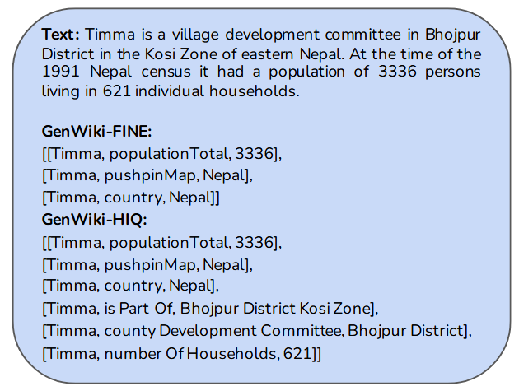
Experiment for demonstration
1. use T5-XL to generate a description for every graph.
2. Use evaluation metrics to calculate the score between the generated description and the corresponding text.

Slide 12
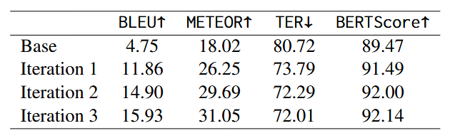
Experiment for demonstration
TER: translation error rate
METEOR: consider more translation metric
Base: GenWiki → low overlap between graph and text
GenWiki is a non-parallel graph-text pairs dataset
Iteration1→3: add more missing triples to the original graph, thus leading the higher quality scores.

Slide 13
Dataset Introduction
KELM
It is a large-scale synthetic corpus that consists of the English Wikidata KG and the corresponding natural text.
~15M but the work takes a sub ~60K
Most triples number is less than six and if sub properties exist it’s not a triple → (S1, R1, R2, O1). So the idea for taking a sub is to triple number is less than six and doesn’t contain sub properties.

Slide 14
Dataset Introduction
WebNLG+2020
It contains a set of triples extracted from Dbpedia.
~38K

Slide 15
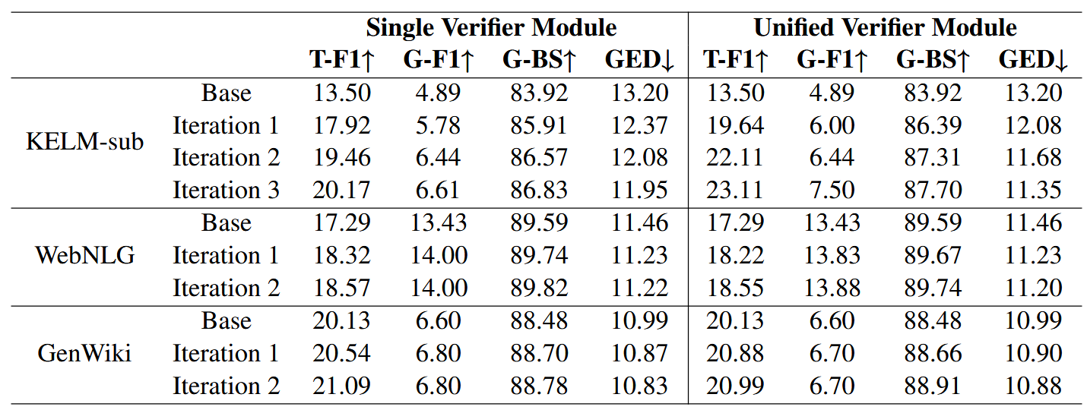



The difference of two verifiers
Two questions.
Why Unified Verifier Module is far better than Single Verifier Module in KELM-sub?
Why G-F1 in GenWiki is the same while iterations going.
Single verifier is the single-specific dataset trained on T5
Unified verifier is the trained on Flan-T5-XXL using instruction fine-tuning.

Slide 16
Iterative ways
1. Iterative prompting
Text → LLM → O1 → Verified→P_i
Prompt ↓
↑ ↓
← ← ← ← ← ← ←
2. Iterative offline correction
Text → LLM → O_i
↑ ← prompt

Slide 17
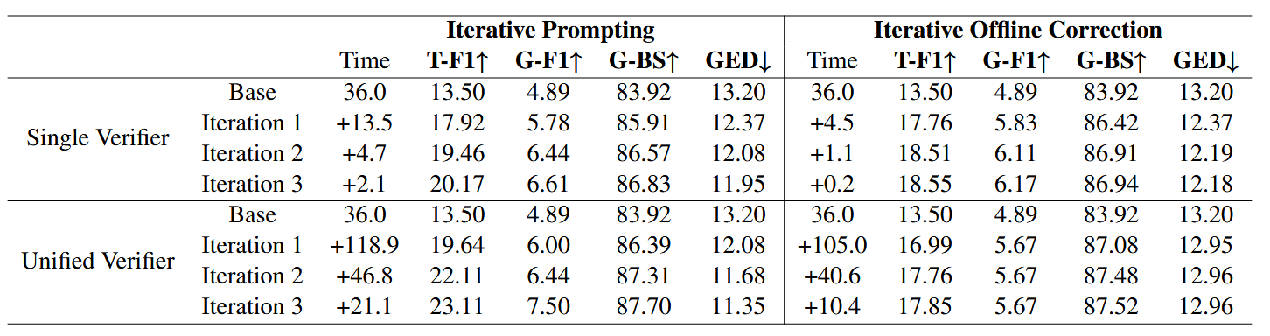

The difference of two iterative

Slide 18
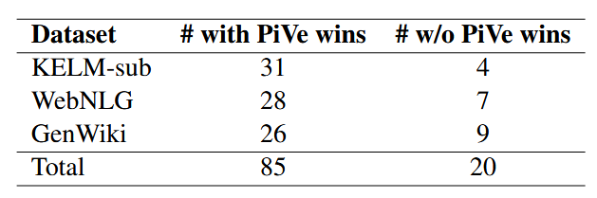
Effect of PiVe
The work recruits three Doctors to evaluate the result.
One result is chatgpt and another is chatgpt+PiVe

Slide 19
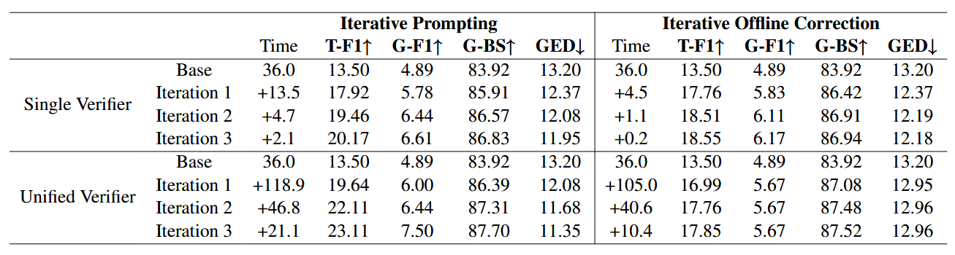
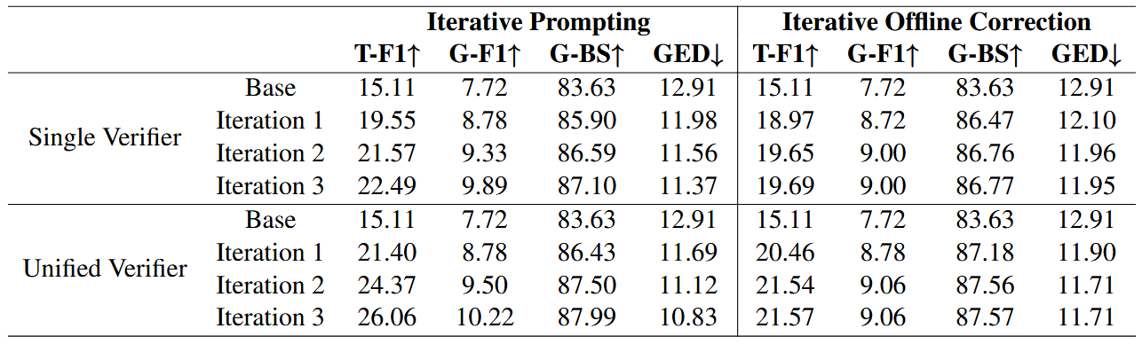
ChatGPT V.S. GPT-3

